Slide 1

AI for Mental Wellness Deep Learning-Based Text Prediction and Assessment
Presented by
A. Laxmi Prasanna
S. Sameeksha
E. Yadgiri

Slide 2

Problem Statement
Unstructured text often hides emotional or mental health cues.
Goal: Classify text into seven categories — Anxiety, Bipolar, Depression, Normal, Personality Disorder, Stress, and Suicidal.

Slide 3
Dataset Overview
Dataset: Combined Data (~53,000 records)
Columns: statement, status
Preprocessing:
Removed nulls and noise
Cleaned control characters
Retained only 7 valid classes

Slide 4

Data Preprocessing
• Tokenization using Keras Tokenizer
• Lowercasing, punctuation removal
• Sequence padding (max_len = 100)
• Label encoding
• Handled class imbalance using class weights and augmentation

Slide 5

Model Experiments
Models Tested:
RNN, GRU, and SVM with Word2Vec
DistilBERT fine-tuning using Hugging Face
Custom BiLSTM trained end-to-end
Goal: Compare contextual vs sequential learning.

Slide 6
Final Model — BiLSTM Architecture
Architecture:
Embedding (100 dim, trainable) → BiLSTM(128) → BiLSTM(64)
→ Dense(128, relu) → Dropout → Dense(7, softmax)
Random initialized embeddings learned during training
Optimized using Adam, categorical crossentropy
Weighted training to fix imbalance

Slide 7

Results — Model Comparison
Model | Accuracy | F1-Score
RNN | 78% | 75%
GRU | 82% | 80%
SVM | 76% | 72%
DistilBERT | 81–90% | 0.88–0.90
BiLSTM | 87–90% | 0.89–0.91
BiLSTM achieved strong accuracy and lower computational cost.

Slide 8
Data Augmentation & Balancing
Added synthetic samples for minority classes (Bipolar, Suicidal, Personality Disorder)
Used NLP synonym augmentation (nlpaug)
Improved minority F1 by +5–8%
Enhanced model stability

Slide 9
Final Evaluation
Balanced performance across all 7 classes
Generated confusion matrix for 53K samples
Fast inference (~milliseconds per text)
Final model: BiLSTM trained with balanced and augmented data.

Slide 10
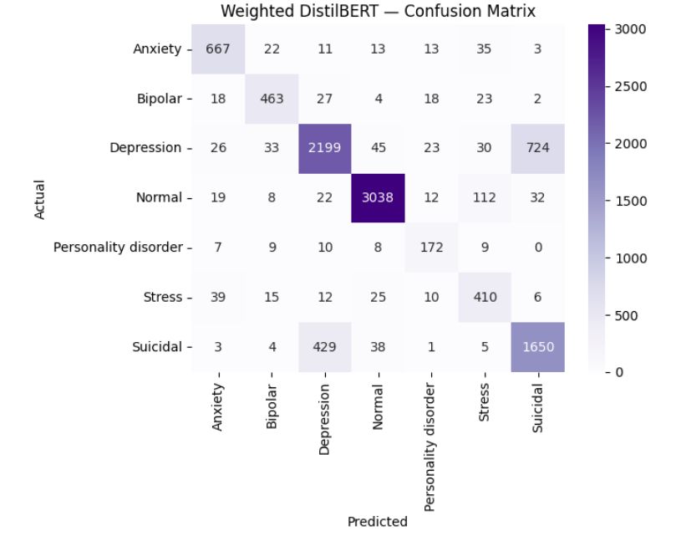
Confusion Matrix

Slide 11
Conclusion & Future Work
✅ BiLSTM proved robust, interpretable, and efficient.
✅ Comparable or better than DistilBERT on this dataset.
Integrate attention or hybrid BERT-BiLSTM
Deploy as a real-time mental health detection API
Extend to multimodal (text + audio) inputs.
Future Enhancements:

Slide 12

THANK YOU

